Slide 1
Online Blockchain-based Certificate Generation and Validation
MENTOR : Mr. Sudhir Goswami
GROUP :
Rishabh, Sujit, Aashi, Vicky
IT Department, REC Bijnor

Slide 2
MOTIVATION
Almost 70% documents on paper - high possibility of it being lost and forged.
Also, verifier has to contact issuer to trust the document presented which leads to a delay. Currently DigiLocker is being used to store and verify documents.
DigiLocker is a centralized system -> highly susceptible to data breaches. Blockchain mitigates this due to its decentralized and tamper-proof nature

Slide 3
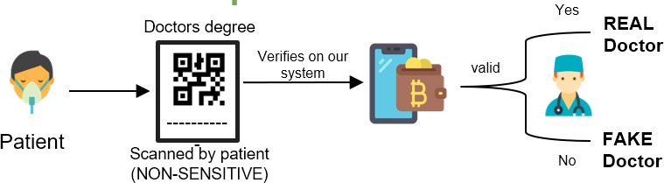
USE CASES

Slide 4
Literature Review
Author
Title
Result Found
Research Gaps
Year
All details added on Blockchain - not ideal as it consumes storage
This paper also doesn’t have a method to verify certificate
Document Management System Empowered by Effective Amalgam of Blockchain and IPFS
Effectively combined both IPFS and Blockchain. This paper also uses the Polygon network due to its lower gas fee
Shikhar Sarang, Dhruv Rana et. al
2022
Qurotul Aini,
Blockchain-Based Certificate
Verification System Management
Implementation based on the Namecoin blockchain.
Demonstrated compatibility with current web standards.
Proposal of an efficient decentralized certificate revocation management system
Existing challenges in certificate revocation management identified. Issues include centralization, high costs, and privacy concerns in current PKI methods
Shikhar Sarang
2022
Eka Purnama Harahap,Po
Abas Sunarya
Blockchain-based Smart Contracts - Applications and Challenges
Blockchain-based smart contracts, emphasizing their evolution, applications, and challenges, focusing on public and permissioned contracts.
Research on smart contracts has highlighted challenges, including security and privacy issues; however, there is a gap in exploring comprehensive solutions and regulations to enhance their practical usability and acceptance.
2019
Yining Hu at El

Slide 5
Literature Review
Author
Title
Result Found
Research Gaps
Year
Nihat Zaman Nursena Bayğın Işıl Karabey Aksakallı
Shikhar Sarang
Digital Certificate
This Paper aims to enhance the
Peoples make fake NFTs that look real but aren't.
2023
_{Security: A Blockchain} trustworthiness of digital
based Approach for Fraud Prevention and Verification
certificates. It Uses blockchain
NFT ownership can be disputed.
and NFTs to prevent counterfeit They were using blockchain itself
certificates and establish a robust verification system.
to store whole document which is extremely costly.
Verification and Validation of Certificates Using Blockchain
Implementation of blockchain ensures secure and streamlined certificate verification.
Dynamic QR codes enhance verification accuracy and reliability. Transparency of the system improves trust in certificate validation processes.
Requirement for university registration may limit accessibility.
Technical complexities of blockchain and smart contracts may pose implementation challenges.
Data accuracy during registration is crucial, susceptible to errors.
Rohan Hargude, Ghule Ashutosh, Abhijit Nawale, Sharad Adsure
2021

Slide 6



ENTITIES
ISSUER
USER
VERIFIER
ISSUES VERIFIABLE CREDENTIALS
IDENTITY HOLDER
VERIFIES CREDENTIALS

Slide 7
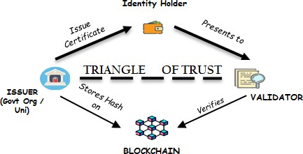
INTERACTION BETWEEN ENTITIES

Slide 8
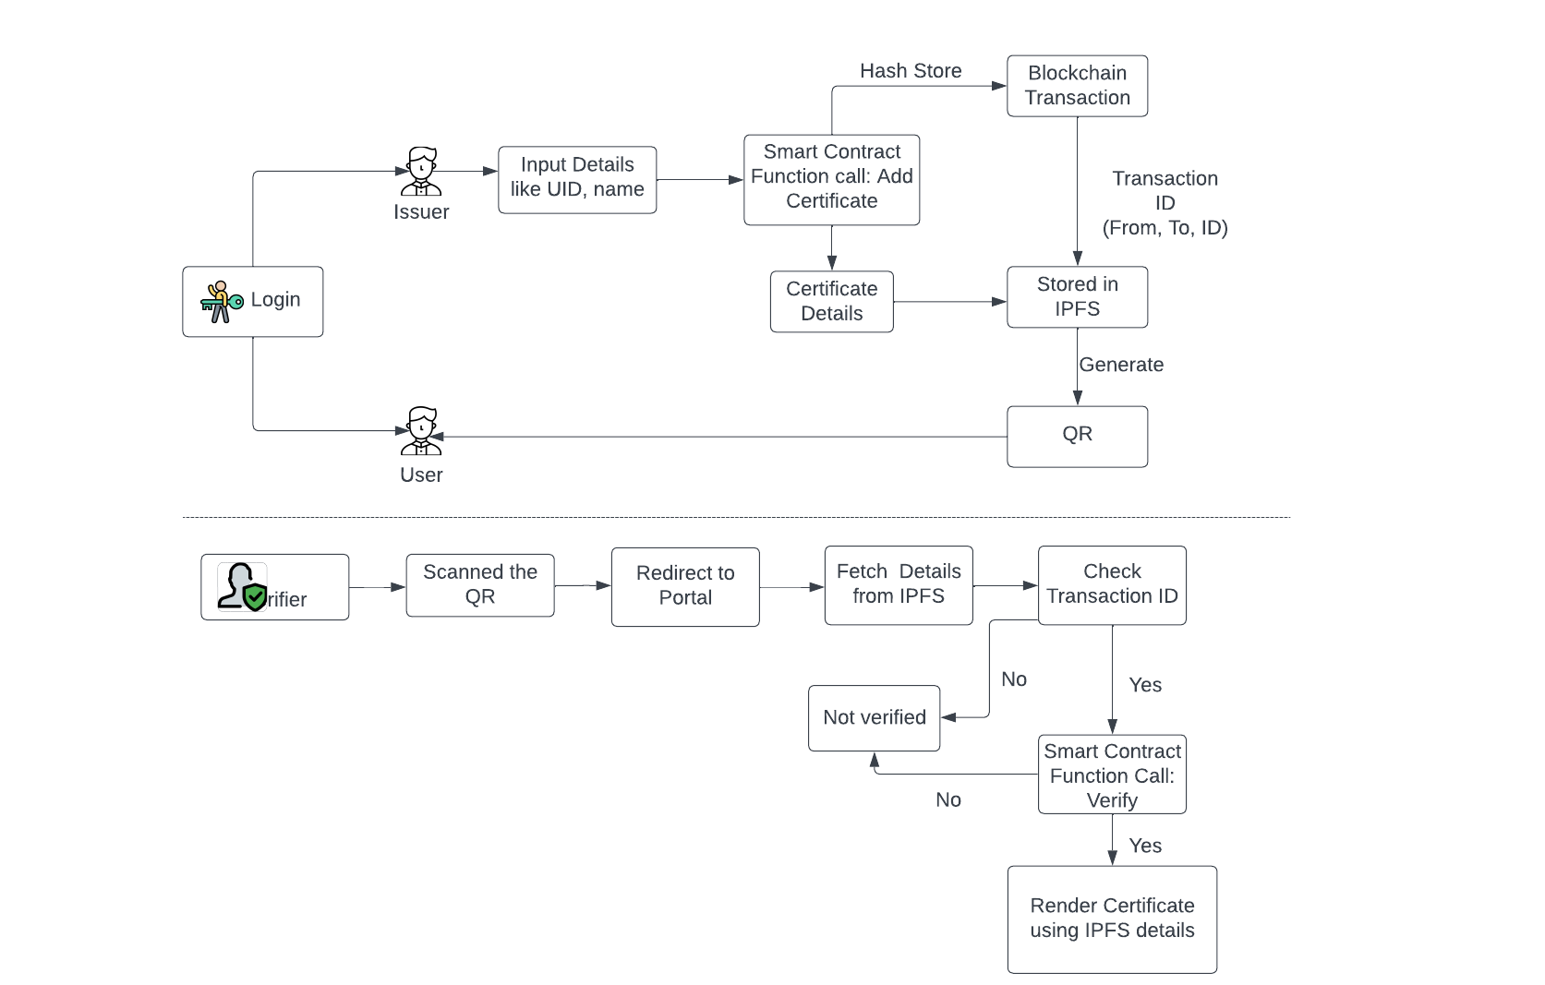
Proposed Methodology:

Slide 9

TECHSTACK:
POLYGON SCAN ETHER.JS MONGO DB METAMASK SOLIDITY
IPFS REACT EXPRESS NODE

Slide 10
DEMO:

Slide 11
REFERENCES:
Hargude, R., Ashutosh, G., Nawale, A., & Adsure, S. (Year). "Verification and Validation of Certificate Using Blockchain." *Computer Department, Pune, India.* ISSN: 2320-2882 Year: 2021.
Author(s): Aruna Seneviratne, Guillaume Jourjon, Kanchana Thilakarathna, Ahsan Manzoor, Madhusanka Liyanage, Yining Hu Title: Verification and Validation of Certificate Using Blockchain Journal/Conference: Computer Department, Pune, India ISSN: 2320-2882 Year: 2019.
Zaman, N., Aksakallı, I. K., & Bayğın, N. (2023). Digital Certificate Security: A Blockchain- based Approach for Fraud Prevention and Verification. Bitlis Eren University Journal of Science, 12(4), 1128-1138. DOI: 10.17798/bitlisfen.1343747
Sarang, S., Rana, D., Patel, S., Savaliya, D., Rao, U. P., & Chaurasia, A. (2022). Document Management System Empowered by Effective Amalgam of Blockchain and IPFS. Procedia Computer Science, 215, 340–349.

Slide 12
THANK YOU

